Slide 1
Farm Fresh Online Store

Slide 2

Road Map
Application will be developed in following Sprints:
Core Java +JPA with Hibernate
Spring Boot + Rest Controller + JPA with Hibernate

Slide 3
Modules
Admin Module
Customer Module
Security Module
Eureka Module
Order Module
Item Module

Slide 4
Modules List:
Admin :
Admin can add fruits into system
with all necessary attributes
Admin can modify fruits like price, name , category e.t.c
admin can delete fruit items
admin can view all items
admin can view customer details
admin can manage order of customer

Slide 5
Modules List:
Customer :
customer need to signup to system
In this module customer will login into system
Once customer will login customer can , In this module customer can view fruits.
customer can search fruits based on fruit name or customer can view fruits in order(low price to high price or high price to low price)
can check availability status of a particular fruit item
in this module customer can check their order details and status
Customer can log out from system.

Slide 6
Modules List:
Item :
Item can be added by admin
In this module item can be modified by admin
In this module item can be deleted by admin
Items can be searched by admin and customer
Items can be sorted by admin and customer

Slide 7
Modules List:
Order :
In this module, order can be added by admin
Order can be modified with by admin
Order can be deleted by admin
Order can be searched admin and customer

Slide 8
Modules List:
Login :
Admin and customer both users should login with user name and password.

Slide 9
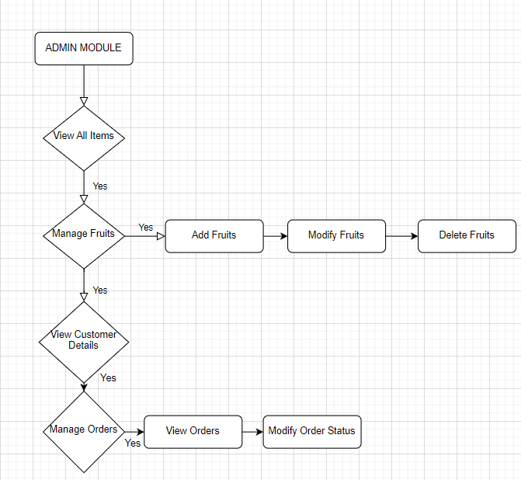
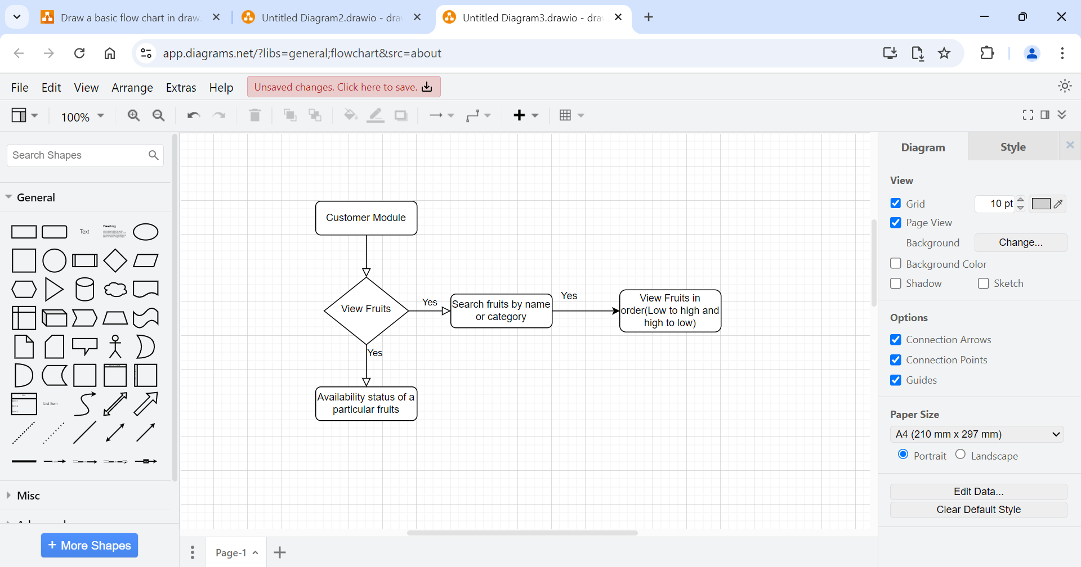
Admin Module
Customer Module

Slide 10
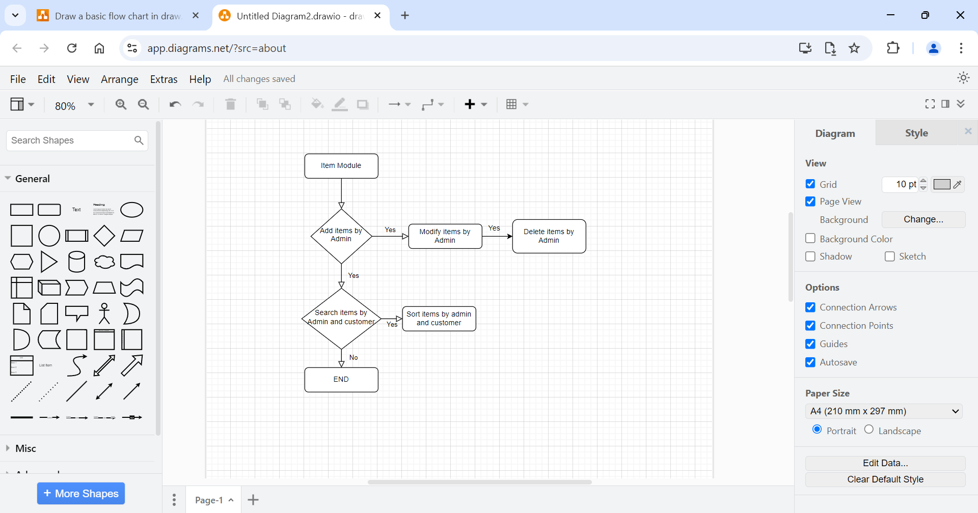
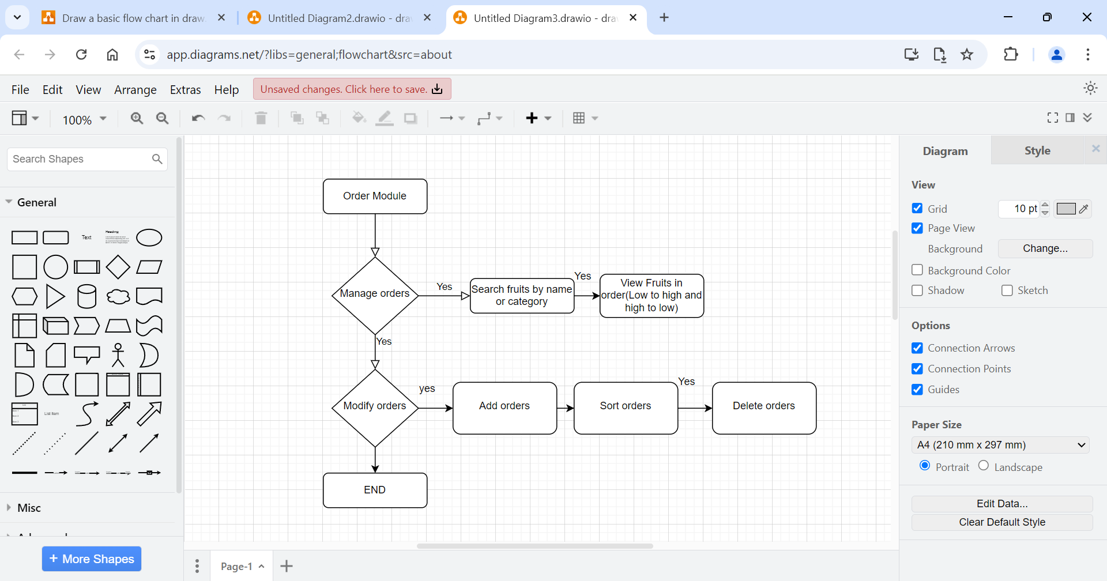
Item Module
Order Module

Slide 11
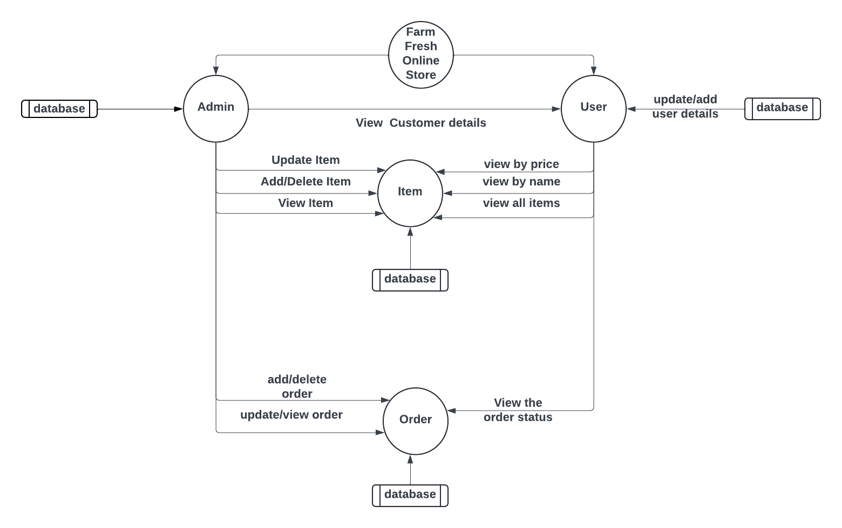
Block Diagram

Slide 12
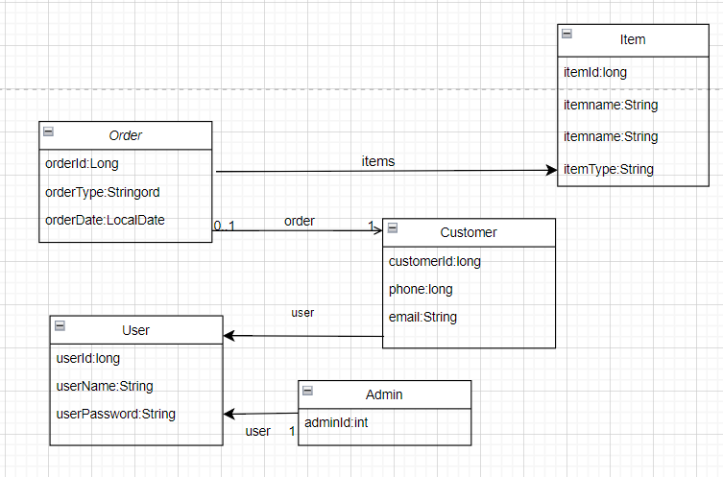

Slide 13



Questions
Case Study by
Eli Yaswanth Kalyan
Kasarapu Druvitha
Aiswarya Lakshmi
Ramya.F
Jefina.Miralin

